Slide 1
Cost estimation

Slide 2
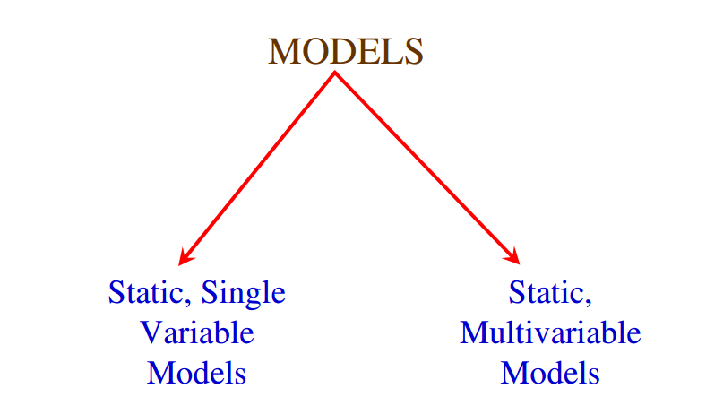


Slide 3
Static, Single Variable Models
use an equation to estimate the desired values such as cost, time, effort, etc.
all depend on the same variable used as predictor (say, size).
An example of the most common equations is:
C = a L ^{b} (i)
C is the cost, L is the size and a,b are constants

Slide 4


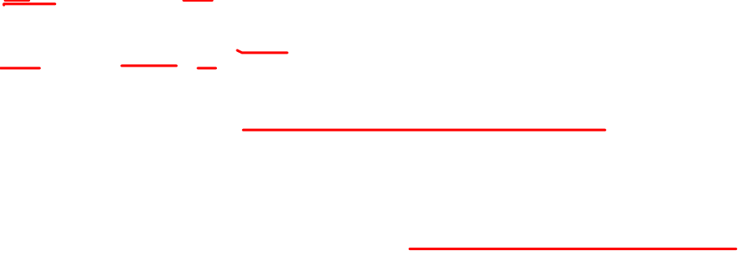



SEL
Software Engineering Laboratory of the university of Maryland established SEL model.
E = 1.4 L^{0.93}
D = 4.6 L^{0.26}
Effort (E in Person-months), duration (D, in months) are calculated from the number of lines of code (L, in thousands of lines) used as a predictor.

Slide 5



Static, Multivariable Models(Walston-Felix model )
These models are often based on equation (i)
they actually depend on several variables representing various aspects of the software development environment, for example method used, user participation, customer oriented changes, memory constraints, etc.
E = 5.3 L ^{0.91}
D = 4.1 L ^{0.36}

Slide 6
Example
Compare the Walston-Felix model with the SEL model on a software development expected to involve 8 person-years of effort.
Software Project Planning (a) Calculate the number of lines of source code that can be produced. (b)Calculate the duration of the development. (c)Calculate the productivity in LOC/PY (d)Calculate the average manning

Slide 7
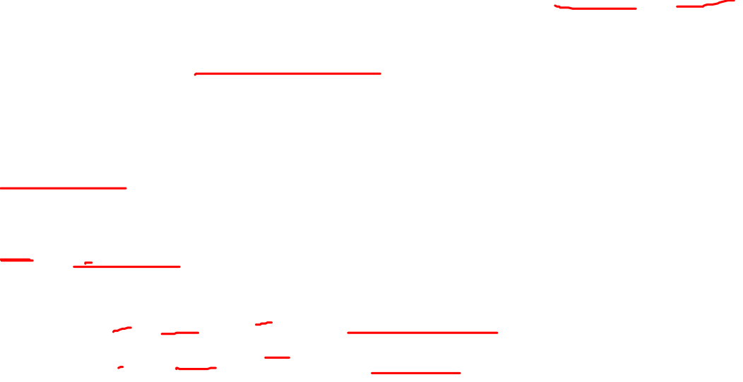
Solution
The amount of manpower involved = 8 PY = 96 person-months (a) Number of lines of source code can be obtained by reversing equation to give:
E = a L ^{b}
L = (E/a)^{1/b}
L(SEL) = (96/1.4)^{1/0.93} = 94264 LOC L(W-F) = (96/5.2)^{1/0.91} = 24632 LOC.

Slide 8

(b) Duration in months can be calculated by means of equation
D(SEL) = = 4.6 (L)^{0.26}
= 4.6 (94.264)^{0.26} = 15 months
D(W-F) = 4.1 L^{0.36} = 4.1 L ^{0.36}
= 4.1(24.632)^{0.36} = 13 months

Slide 9
(c) Productivity is the lines of code produced per person/month (year)
P (SEL) = 94264 /8 = 11783 LOC / Person−Years
P (W − F) =24632/8= 3079 LOC / Person −Years

Slide 10
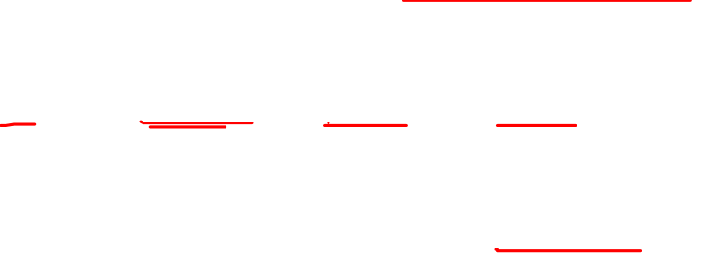
(d) Average manning is the average number of persons required per month in the project.
M(SEL) = 96 P-M/15M = 6.4 persons
M(W-F) = 96 P-M/13M = 7.4 persons

